Slide 1
Desmopressin for reversal of Antiplatelet drugs in Stroke due to Haemorrhage (DASH)
DASH-1.ac.uk
Created January 2020
Protocol version 2.0
DASH-1.ac.uk 17 Jan 2020 v1.7

Slide 2
Aims and Objectives:
Background
Study design
Inclusion criteria
Consent process
Randomisation
Passwords and website access
Drug storage and administration
eCRF completion – baseline, end of treatment, day 2 (24 hours), day 90 (telephone follow-up)
Site file
Please complete training log of all attendees!
DASH-1.ac.uk
Notes:
NS

Slide 3
Background - ICH:
Common
Significant mortality and morbidity
Early 20% mortality
Associated with bad outcome:
Haematoma volume Intra-Ventricular Haemorrhage Haematoma expansion
Haematoma expansion occurs early
Preventing haematoma expansion may improve outcome
DASH-1.ac.uk

Slide 4
Desmopressin
Licensed pro-haemostatic drug
Can be administered IV, SC, IN or orally
Used in a number of inherited bleeding conditions to treat or prevent bleeding
Recommended for the reversal of antiplatelet drugs in USA but not in UK
Meta-analysis in patients undergoing cardiac surgery was found to reduce blood loss and transfusion requirements
Has been tested in spontaneous ICH in three case series where it appears to be safe
More than 13 million people worldwide have been treated with desmopressin
DASH-1.ac.uk

Slide 5
Feasibility:
Proportion of eligible patients who are enrolled and receive randomised treatment
Proportion of patients who were screened who were eligible
Proportion of eligible patients approached who were randomised
Rate of participant recruitment per month per site
Time to randomisation following hospital admission
Adherence to allocated treatment
Proportion of participants followed up to 90 days and reasons for loss to follow up
Proportion of randomised participants with the proposed primary and secondary outcome data available
DASH-1.ac.uk

Slide 6
DASH: Inclusion criteria
Adults (18 years or more)
Confirmed intracerebral haemorrhage on imaging
Less than 24 hours from onset of symptoms [or from when last seen free of stroke symptoms]
Prescribed and thought to be taking a daily oral antiplatelet drug in the preceding seven days (cyclooxygenase inhibitors, phosphodiesterase inhibitors or P2Y₁₂ inhibitors)
Signed consent (or waiver of consent)
DASH-1.ac.uk
Notes:
NS
Must be spontaneous

Slide 7
DASH: Exclusion criteria
Aneurysmal subarachnoid haemorrhage known at time of enrolment
Haemorrhage suspected to be due to transformation of ischaemic stroke
Haemorrhage known to be due to thrombolytic drug
Haemorrhage known to be due to venous thrombosis
Risk(s) of fluid retention associated with desmopressin judged clinically significant by the attending physician
DASH-1.ac.uk

Slide 8
DASH: Exclusion criteria continued
Significant hypotension (systolic blood pressure <90mmHg)
Known drug-eluting coronary artery stent in previous three months
Allergy to desmopressin; pregnant or breast-feeding (do pregnancy test if needed)
Life expectancy less than four hours, or planned for palliative care only
Glasgow coma scale <5
mRS >4
DASH-1.ac.uk

Slide 9
DASH: Consent
Consent by someone appropriately trained and on delegation log
3 copies of consent – original in site file
Remember to inform GP and keep copy of GP letter in the medical records/site file
DASH-1.ac.uk
Notes:
NS

Slide 10
DASH: Consent flowchart
DASH-1.ac.uk

Slide 11
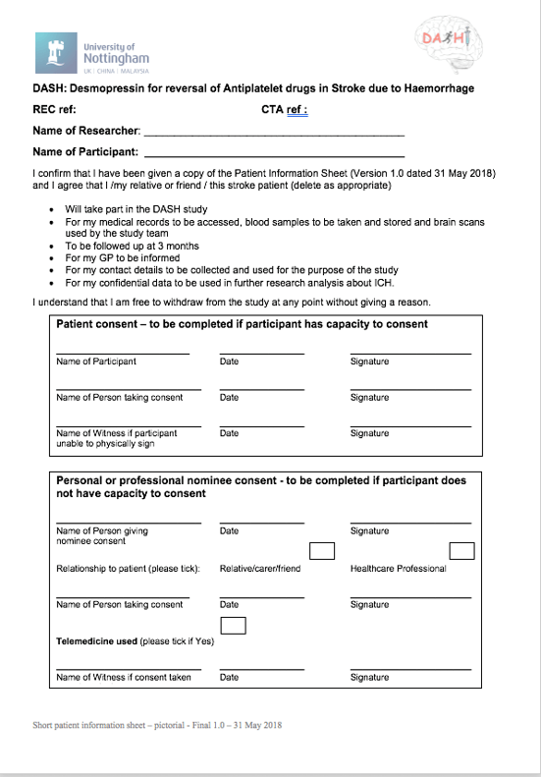
DASH Pictorial Consent form:
Where possible get full informed consent form signed ASAP
Master copy of consent to be filed in site file and a copy sent to the trial office
DASH-1.ac.uk
Notes:
NS

Slide 12
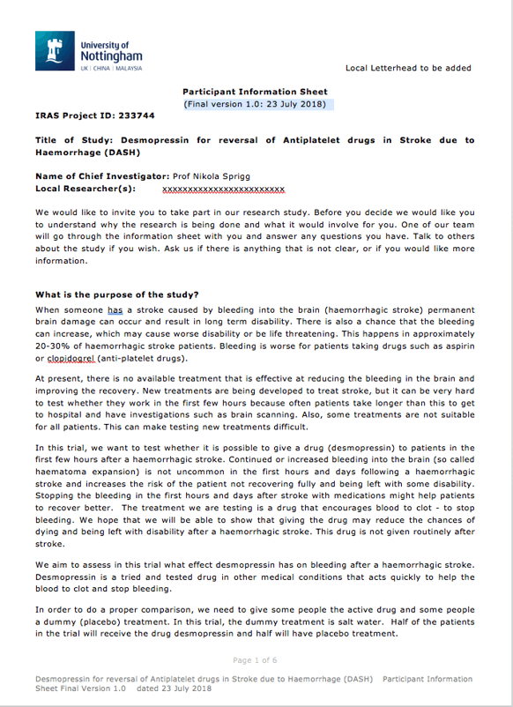
DASH Pictorial Consent form:
Ensure patient is also given a copy of the full patient info. sheet
Where possible get full informed consent form signed ASAP
Master copy of consent to be filed in site file and a copy sent to the trial office
DASH-1.ac.uk
Notes:
NS

Slide 13
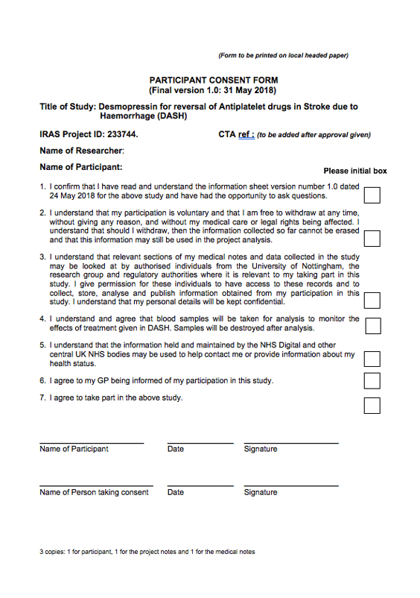
Participant consent
Patient Information Sheet
Full Patient Consent
DASH-1.ac.uk
Notes:
NS

Slide 14
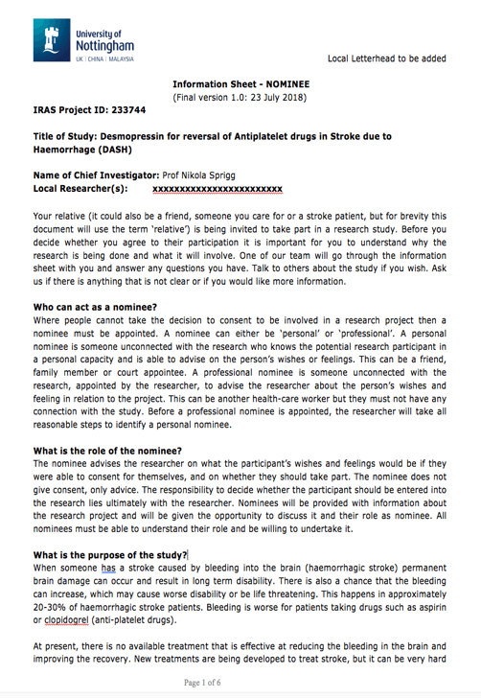
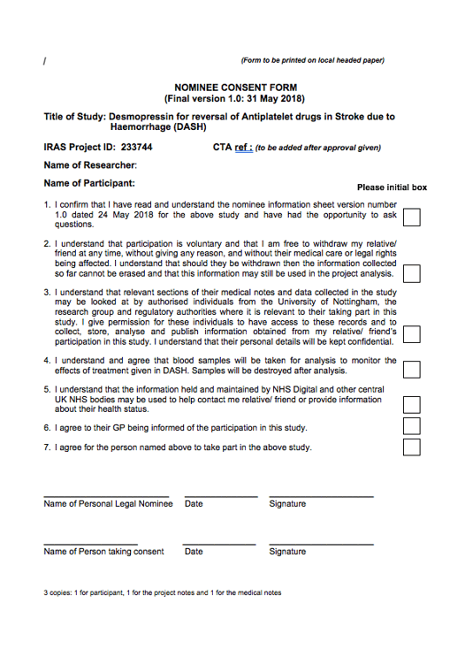
Nominee forms:
Personal: Can be signed by a relative or close friend
Professional: A doctor can sign if no relative available
Doctor must be unconnected with DASH (not on the delegation log)
If nominee form used by professional – attempt to get consent or personal nominee consent within 72 hours if possible.
Nominee Information Sheet
Nominee Consent
DASH-1.ac.uk
Notes:
NS

Slide 15
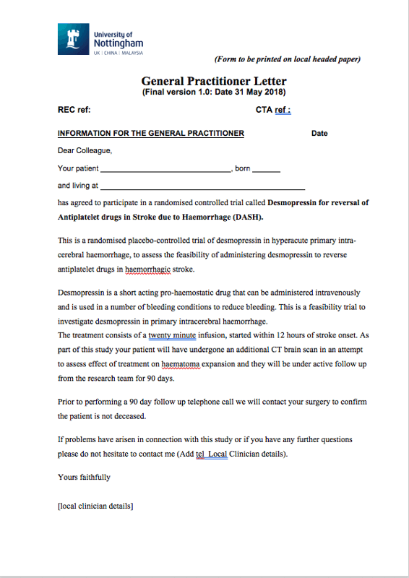
General Practitioner letter
Always send a letter to the participant's general practitioner
File copy in Investigator Site File (with consent/pt details)
Include a copy of the consent/PIS/GP letter in to the medical records
Anonyomised/ unanomymised to be kept separate
DASH-1.ac.uk
Notes:
NS
Please keep GP letter, Consent form(s) and patient details together in the ISF

Slide 16
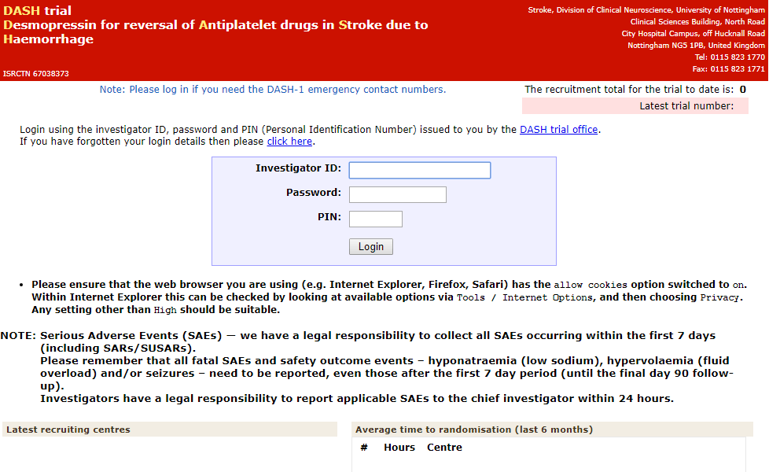
DASH-1 Logging onto website
Account details and PIN will be sent via email
PI must activate before site can recruit
Password reset on-line
DASH-1.ac.uk
Notes:
Coordinator
Demo website (www.tich-2.org)
To get passwords we need:
Delegation log signed by PI
Signed CV and GCP certificate (in last 2 years)

Slide 17
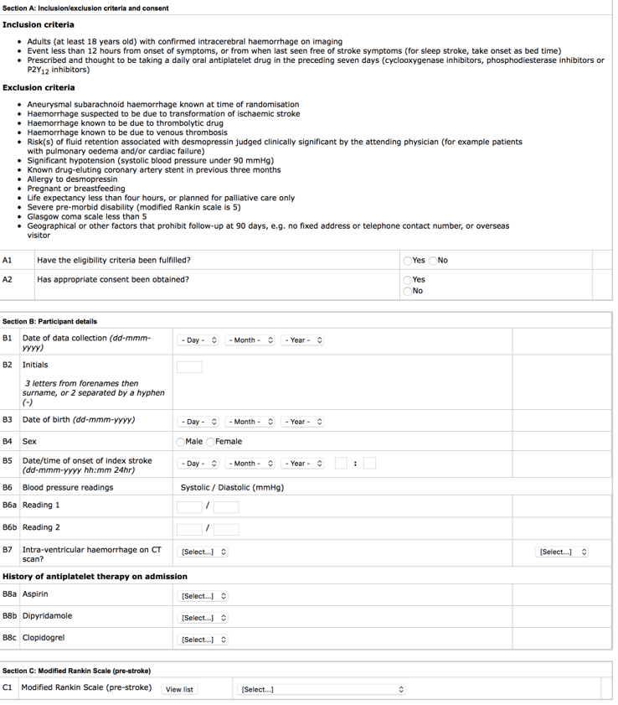
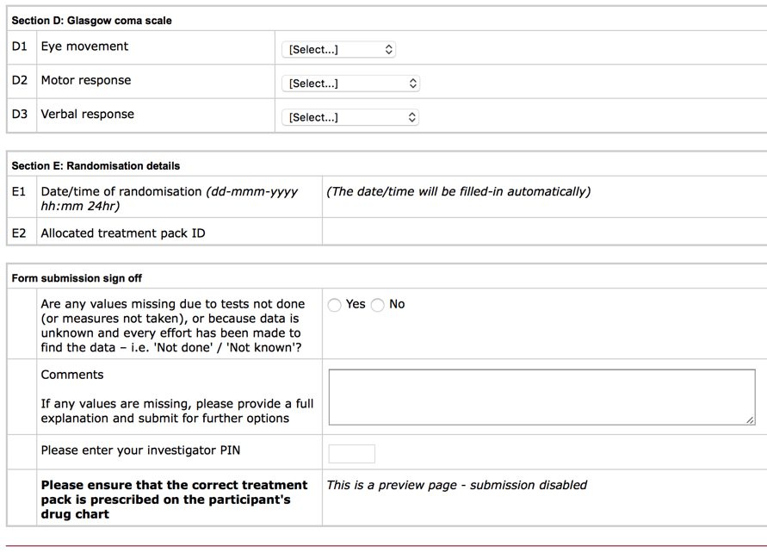
DASH-1: Randomisation
On-line DASH-1.ac.uk
17
DASH-1.ac.uk
Notes:
Coordinator

Slide 18
DASH: Randomisation
Emergency randomisation procedure
Emergency telephone numbers available
If a hospital site is down
If the actual trial website is down
If unable to access website or contact emergency numbers – please use lowest treatment pack and inform trial office ASAP
DASH-1.ac.uk
Notes:
Coordinator
Contact details should be kept in the front of the ISF
Keep a copy of printed randomisation CRF easily accessible

Slide 19
Intervention/Control:
Intravenous desmopressin (DDAVP) ampoules or placebo of intravenous Sodium Chloride 0.9% ampoules
Needs to be stored in a fridge 2ºC to 8ºC
Desmopressin 20μg OR Sodium Chloride 0.9% will be added to 50ml Sodium Chloride 0.9% and infused over 20 minutes
Temperature excursions below 2ºC and above 8ºC should be reported to the clinical trials pharmacy and the trial office as soon as possible
DASH-1.ac.uk

Slide 20
Packaging and labelling
Nottingham University Hospital pharmacy will prepare blinded individual treatment packs containing: 5 x 1ml or 3 x 2ml glass ampoules containing either desmopressin 20µg or sodium chloride 0.9%. These will be non-identical.
The carton and the ampoules contained within it will be labelled with the same unique pack number.
Detailed prescribing and administration instructions will be provided in the treatment pack.
Empty packaging and used ampoules can be disposed of on the ward after completion of accountability log.
Unused IMP should be returned to clinical trials pharmacy.
DASH-1.ac.uk

Slide 21
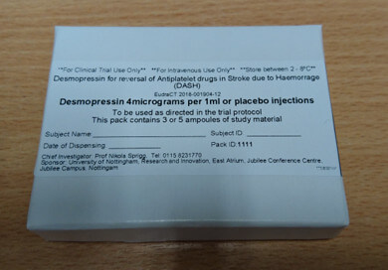
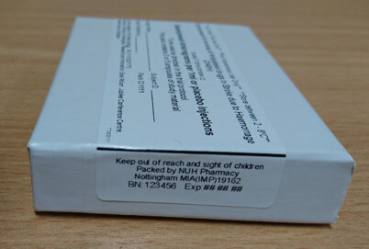
Drug administration:
Desmopressin 20μg OR Sodium Chloride 0.9% will be added to 50ml Sodium Chloride 0.9% and infused over 20 minutes
20 minute infusion is aimed at reducing side effects from flushing
Drug needs to be stored in fridge at 2 to 8 degrees Celsius
Participant trial number and pack ID must be recorded on the drug card
DASH-1.ac.uk

Slide 22
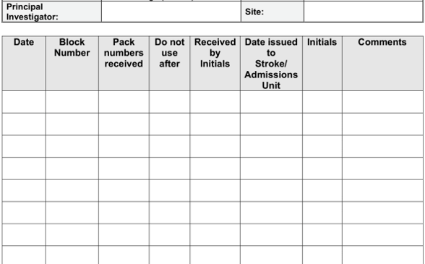
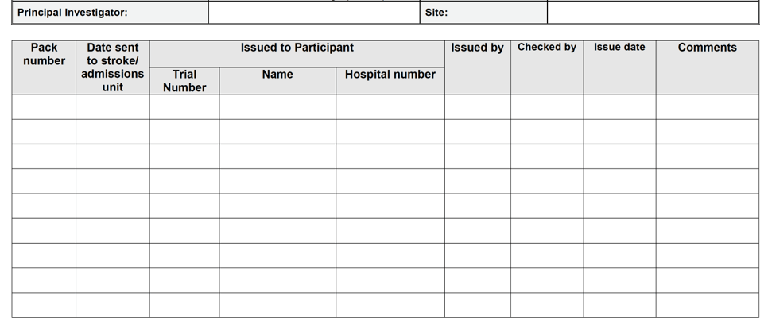
DASH: Drug documentation
Accountability log
Check stock regularly
Store drug in fridge at 2ºC to 8º
Continuous temperature monitoring not required
Inventory log
kept in pharmacy
DASH-1.ac.uk
Notes:
Coordinator

Slide 23
IMP: Temperature monitoring
Desmopressin should be stored in a refrigerator between 2ºC and 8ºC.
Temperatures should be recorded DAILY. Temperature deviations must be reported as follows.
Temperature Deviation:
< 2ºC - DO NOT USE
Immediately return all affected supplies to local site pharmacy unused. A
temperature excursion form should be completed and forwarded to the DASH Trial Team (dash@nottingham.ac.uk), who will advise on the course of
action.
>8ºC to ≤ 25ºC
Continue to store in the refrigerator but complete details on the cumulative temperature excursion form. Information from the manufacturer confirms the product is suitable for use when stored between 9ºC and 25ºC for a cumulative period up to 28 days. (672 hours)
Temperature excursions between 9ºC and 25ºC only need to be reported to the DASH Trial Team, if the cumulative time period out of range is greater than 28 days.(672hours)
> 25ºC - DO NOT USE
Immediately return all affected supplies to local site pharmacy unused. A
temperature excursion form should be completed and forwarded to the DASH Trial Team (dash@nottingham.ac.uk), who will advise on the course of
action.
DASH-1.ac.uk
Version 3, 17.01.2020 BC/SH WpdNo2

Slide 24
Blood tests
Before desmopressin
P-Selectin¹
VWF antigen, VWF activity and factor VIII²
60 minutes after desmopressin
VWF antigen, VWF activity and factor VIII²
24 hours after desmopressin, check sodium levels³
See WPD for further details
Send to Division of Cardiovascular Medicine at Queen's Medical Centre, Nottingham
Freeze and store samples locally and transport for central analysis at the end of the trial
Run test locally
DASH-1.ac.uk

Slide 25
Processing blood tests: VWF antigen, VWF activity and factor VIII
Blood samples drawn into citrate (at least 5ml – e.g. 2 x 2.7ml tubes)
Tubes must be filled to the line
Please use your own blood tubes
Centrifuge blood at 2500g for 15 minutes
Aspirate platelet poor plasma and separate into 1ml aliquots
Store plasma samples locally (-70ºC to -80ºC) in a linked anonymised format, labelled using a combination of study reference and unique study identifier
Record plasma samples using the DASH Blood Sample Freezer Log
Samples will be transported on dry ice at the end of the trial for central analysis
DASH-1.ac.uk

Slide 26
Processing blood tests: P-Selectin
Blood samples for P-Selectin will be taken from all participants at baseline (5ml citrate blood tube included in P-Selectin pack).
Fix samples (to allow batching of samples) and post to the Division of Cardiovascular Medicine, Queen’s Medical Centre, Nottingham on the same day using pre-prepared blood sample containers
DASH-1.ac.uk

Slide 27
P-selectin instruction sheet
DASH-1.ac.uk

Slide 28
Page 2:
DASH-1.ac.uk

Slide 29
Participant contact details
Vital we can contact patient at day 90 for follow up
Ensure completed fully
Consider taking:
An email address
Mobile number of relative
Preferably two different methods of telephone contact of participant
Participant contact details remain current on the trial database
DASH-1.ac.uk
Notes:
Coordinator

Slide 30
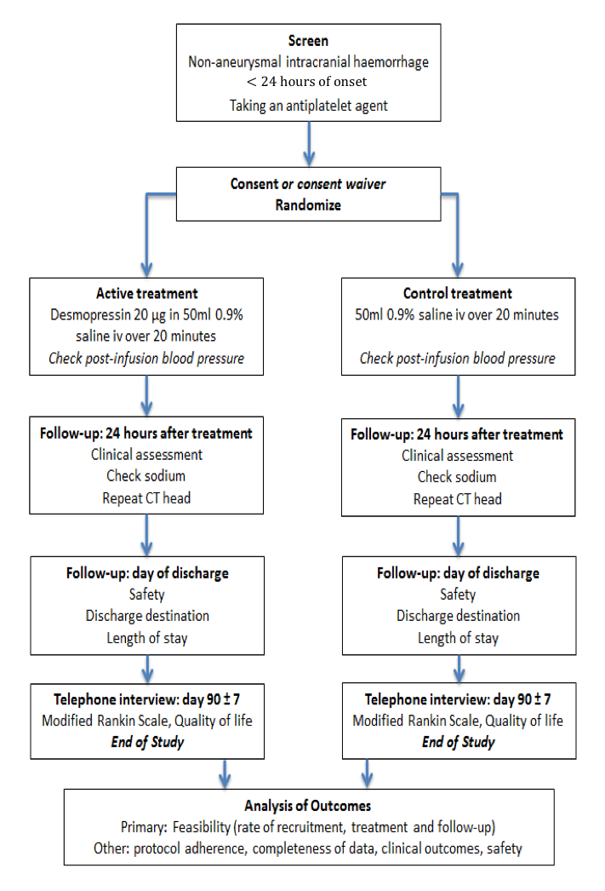
Flow chart:
Randomisation, Day 1
Day 1 follow up form
Day 2 follow up form
Death/discharge form
Day 90 telephone f/up by Nottingham
SAE form (days 1-90)
30
DASH-1.ac.uk
Notes:
Coordinator

Slide 31
DASH: Missing Data (WPD 3)
Some CRFs have option of 'Not applicable' and/or 'Not known'
Some options are hidden and can only be accessed if at bottom of CRF is marked as 'missing/not done' and reason for missing data is given.
NOT APPLICABLE - should be used if a measure was not required.
NOT DONE - should be used if a measurement was not taken or test not performed.
NOT KNOWN - should be used if the data is unknown at that time but will be available later.
DASH-1.ac.uk
Notes:
Coordinator

Slide 32
DASH: SAE Reporting
Serious Adverse Event (SAE) is any of:
Death
A life-threatening adverse event
Inpatient hospitalisation or prolongation of existing hospitalisation
A disability / incapacity
A congenital anomaly in the offspring of a participant
Medically important
Assess expectedness according to SmPC on website (http://dash-1.ac.uk/docs/)
Days 1-7: Collect all SAEs (including SARs/SUSARs)
Days 1 – 90 All SUSARS, fatal SAEs and safety outcomes
Discuss with clinicians and PI
SAEs are reported electronically on the website
DASH-1.ac.uk
Notes:
Coordinator
Not for expeditied reporting, but still need to be recorded

Slide 33
DASH: Safety outcomes
All SAEs for 7 days
All fatal SAEs up to 90 days
Hyponatraemia Na < 135 up to 90 days
Fluid overload up to 90 days
Seizures up to 90 days
If in doubt please speak to the trial office
DASH-1.ac.uk
Notes:
Coordinator

Slide 34
Protocol violations:
Major deviation from the trial protocol where a participant is enrolled in spite of not fulfilling all the inclusion and exclusion criteria, or where deviations from the protocol could affect the trial delivery or interpretation significantly.
Examples:
Participant did not meet inclusion criteria
Not receiving randomised treatment
SAEs not reported in the required time frame
If in doubt contact trial office
Online form can be used for participant or non-participant violations
DASH-1.ac.uk
Notes:
Coordinator

Slide 35
Data to send to Nottingham:
Contact details, drug chart, CT reports and consent forms to be faxed or sent via secure email after enrolment
We will check full informed consent has been obtained
Trial screening log faxed monthly (include all patients approached) and include randomised participants
Image collection Collect all acute images, SAEs
Image transfer - think data protection!
Upload facility Postal
DASH-1.ac.uk
Notes:
Coordinator
Screening log
All eligible participants who are recruited
All eligible participants but were not approached (no staff available, out of hours etc.)
All eligible participants but did not want to take part – try get reason if they are willing to give this

Slide 36
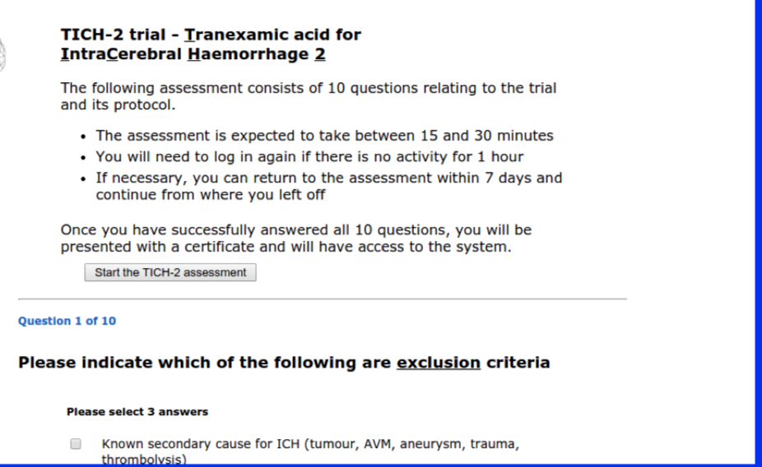
New investigators:
Must send the following to the NCC:
GCP certificate (within last 2 years)
Signed CV and dated
Delegation log – authorised by the PI – this can be done after completion of the training
DASH Training
Certificate
DASH Training Assessment
This is to certify the above has
completed Online DASH training
Start the DASH assessment
DASH-1.ac.uk
Notes:
Coordinator
Medics who will only consent need to attend this SIV or the MUST do the online training as well as send Delegation log and GCP cert.

Slide 37
DASH Monitoring:
All sites who recruit WILL be monitored
Ensure trial documentation up to date
Ensure delegation log up to date
Record source data in the medical notes: NIHSS, BP, GCS
Commonly found issues
mREC/MHRA/R&D Amendment approvals are hard to locate or are missing
SAEs are not signed by the PI
Screening log not kept up to date
File notes missing which identify where documents are stored outside of the ISF (CVs and GCP certificates etc.)
Anonymised information must be kept separate from identifiable data
Consent forms are ticked rather than initialled
Team members should be authorised onto the electronic delegation log
DASH-1.ac.uk
Notes:
Coordinator

Slide 38
DASH Contacts:
Stroke Trials Unit
Telephone: +44 (0)115 8231770
Fax: +44 (0)115 8231771
Trial Manager
Di Havard +44 (0)115 823 1775
Trial Co-ordinator
Sharon Ellender +44 (0)115 823 1659
Trial Administrator
Patricia Robinson +44 (0)115 823 1672
Documents: http://dash-1.ac.uk/docs/
Emergency contact numbers:
+44 (0)7736 843592 Mike Desborough
+44 (0)7725 580092 Nikola Sprigg
+44 (0)7798 670726 Philip Bath
DASH-1.ac.uk
Notes:
Coordinator

Slide 39
DASH Site file:
Contact sheet
Trial personnel details – CVs, GCP certs, training logs
Current approved protocol
Approved and localised: information sheets, consent forms and GP letter
Regulatory approvals and sponsor documents
Standard Operating Procedure, Working practice documents including emergency unblinding
Clinical Trial Agreement
Medication section
Monitoring
Safety – file SAE forms here after sign off by PI
All 'wet-ink' signed informed consent forms
Site screening logs
DASH-1.ac.uk
Notes:
Coordinator

Slide 40
Amendments to protocol: SA03
Major amendment – Protocol v 2.0 26.08.19
Inclusion criteria changed to: Less than 24 hours from onset of symptoms [or from when last seen free of stroke symptoms]. This inclusion criterion was previously “onset of symptoms within 12 hours”.
Ethics approval: 24 Oct 2019
MHRA approval: 22 Nov 2019
HRA approval: 24 Oct 2019
Documents uploaded to website
DASH-1.ac.uk

Slide 41
SA03 Documents:
DASH-MHRA- Notification of Acceptance- Dated; 22 Nov 2019
DASH- Participant Information Sheet - Final version 2.0: 26 August 2019
DASH- Participant Information Sheet -Nominee- Final version- 2.0: 26 August 2019
DASH- Protocol Final version -2.0: 26 August 2019
DASH-HRA Approval Letter -Dated; 24 Oct 2019
DASH-GP Letter Final version - 2.0: 26 August 2019
SA03 summary of Protocol Changes
Day 90 Practice Manager Letter – Only required at the coordinating site
DASH-1.ac.uk

Slide 42
Summary:
Adults (≥18 years)
Confirmed intracerebral haemorrhage on imaging
Less than 24 hours from onset of symptoms [or from when last seen free of stroke symptoms]
Prescribed and thought to be taking a daily oral antiplatelet drug in the preceding seven days
Doctor taking consent and prescribing MUST be on delegation log
Professional nominee consent MUST be followed by consent
Repeat CT needed at 24 hours after treatment
Record research visits in medical records for monitoring
SAEs must be reported within 24 hours and then printed off and signed by the PI
DASH-1.ac.uk
Notes:
Coordinator
Niki – can non consent medics do the prescribing? (readers notes in slide 25)

Slide 43
Desmopressin for reversal of Antiplatelet drugs in Stroke due to Haemorrhage (DASH)
Any questions?
Please complete and fax training log of all attendees for today's SIV!
DASH-1.ac.uk
DASH-1.ac.uk
Notes:
Coordinator

